Slide 1
Weather and Climate
Dave DuBois, State Climatologist
College of Agricultural, Consumer and Environmental Sciences
Department of Plant and Environmental Sciences
Master Watershed Conservation Program
Forum 2L Weather, Climate Droughts & Flooding
October 26, 2021

Slide 2
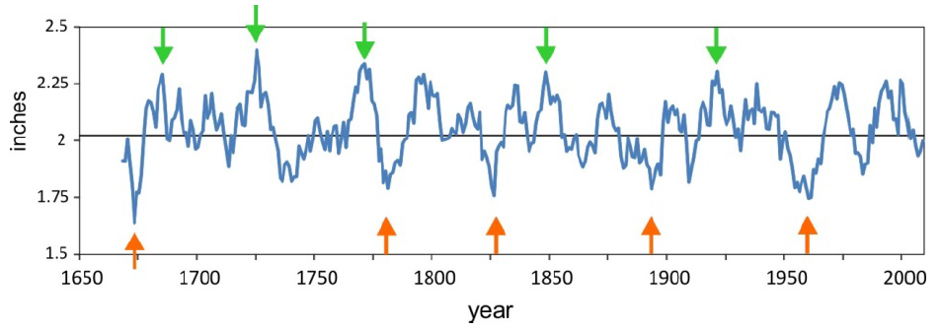
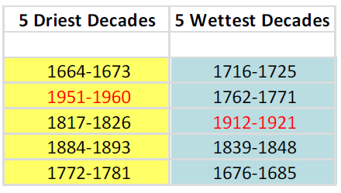
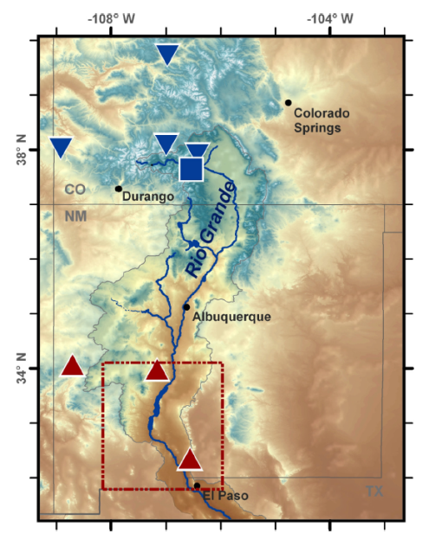
Lower Rio Grande June-July Precipitation Reconstruction
Blue line:
10-yr moving average
349 years of data
Recent droughts not as intense as those in the past
Woodhouse et al. (2013)

Slide 3
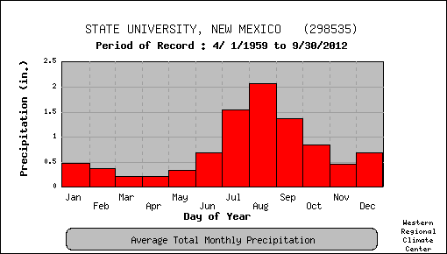
Las Cruces (NMSU) Climatology
Period of record 1895-present
Extreme cold -10°F (1/11/1962)
Extreme hot 110°F (6/26/1994)
Most 24-hr precipitation 6.49” (8/30/1935)
Wettest year was 1941 (19.6”)
Wettest JAS was 1941 (12.16”)
Snowiest year was 1931 (14.2”)

Slide 4
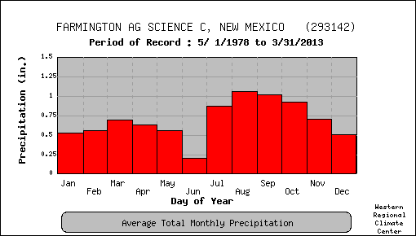
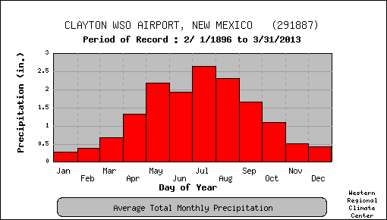
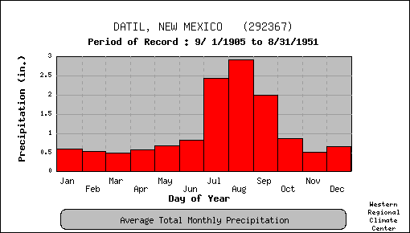
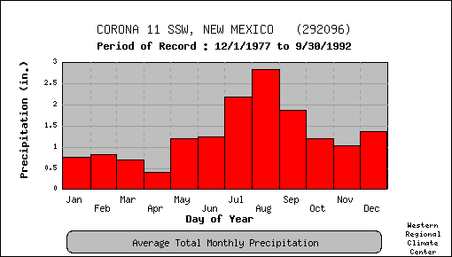
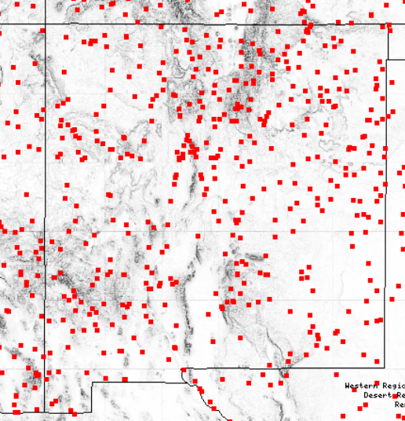

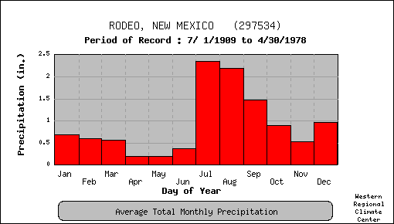
Seasonal patterns of precipitation in NM
http://www.wrcc.dri.edu/summary/Climsmaz.html

Slide 5
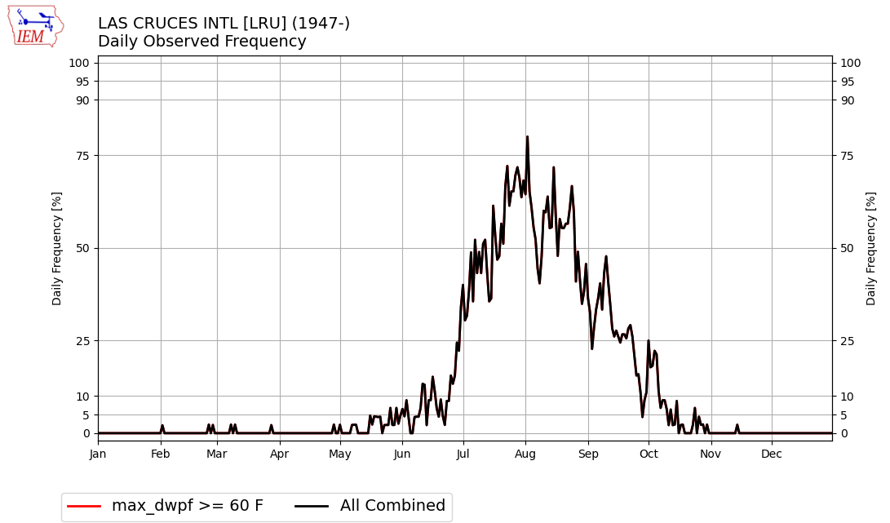
Frequency of occurrence of a maximum dewpoint of 60ºF

Slide 6
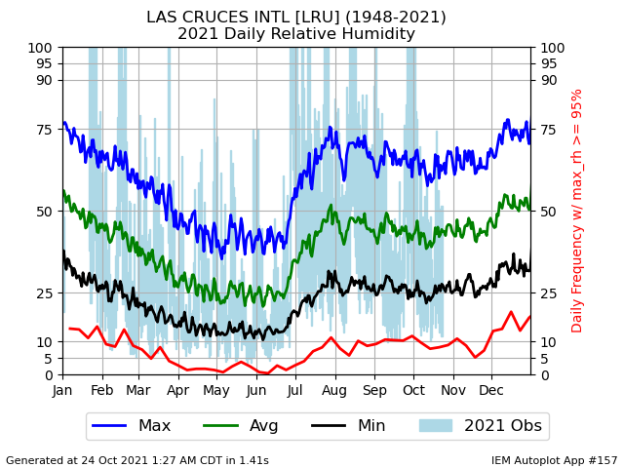

Slide 7
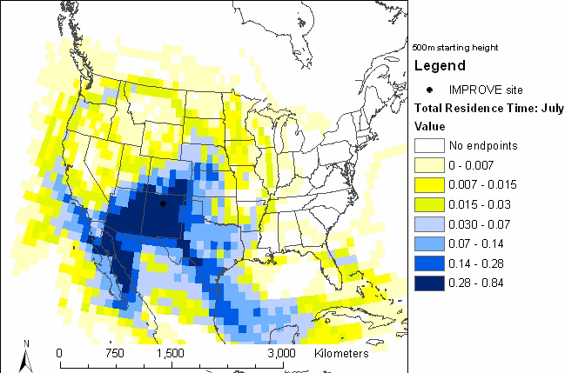
Our summer monsoon pattern
3-yr backtrajectories from Bandelier in July. Run every 3-hr using HYSPLIT at 500m with EDAS winds
Shows southwesterly flow & a significant southeast flow from Gulf of Mexico
More research is needed to assess how climate change might be affecting our North American Monsoon

Slide 8
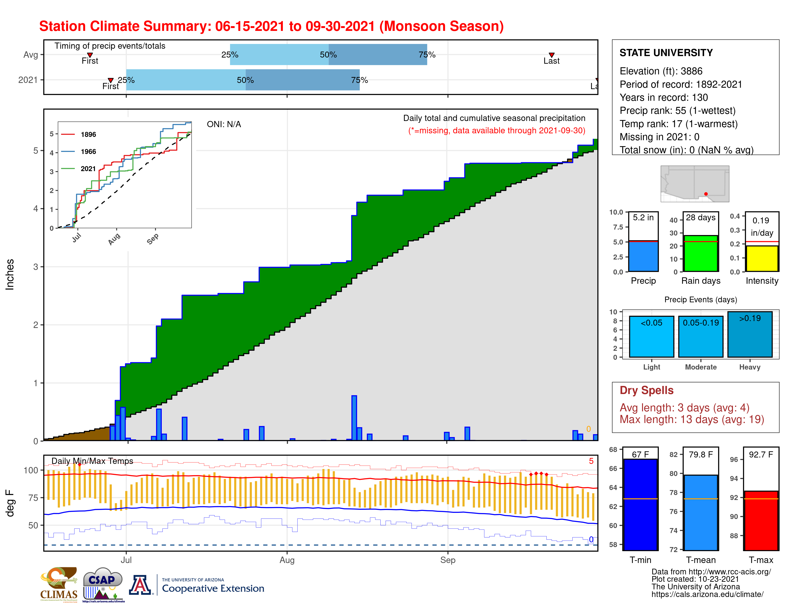

Slide 9
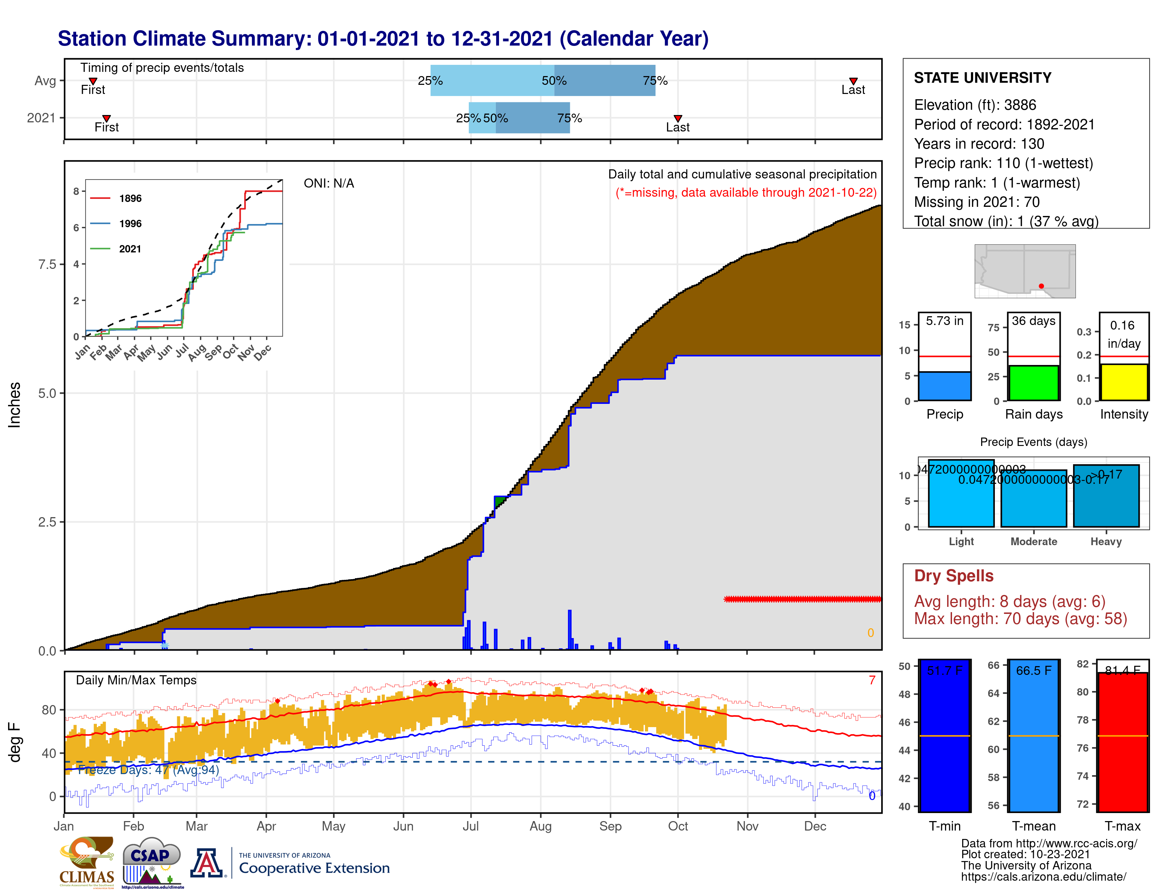

Slide 10
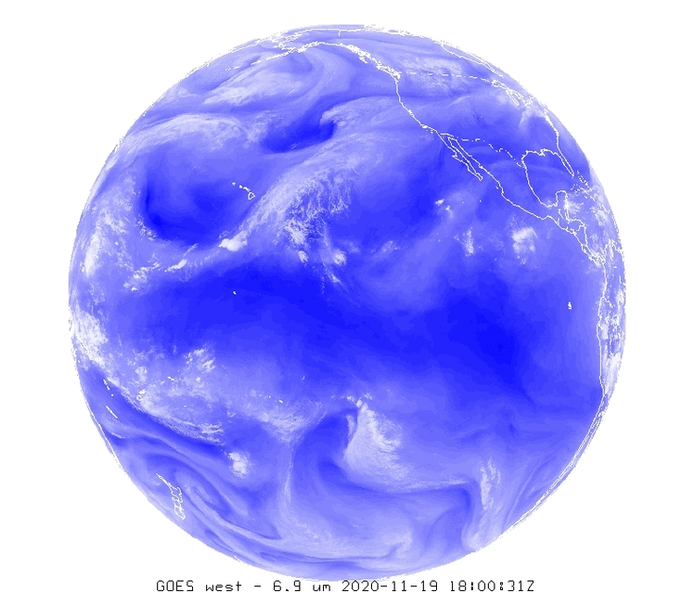
What causes weather variability?
It depends on what time scale:
Polar vortex
PNA
Storm
tracks
Daily
Weekly to monthly
Seasonal
Year to year
Decadal to multi-decadal
Longer term
PDO
Tropical
cyclones
monsoon
Atmospheric rivers
MJO
ENSO

Slide 11
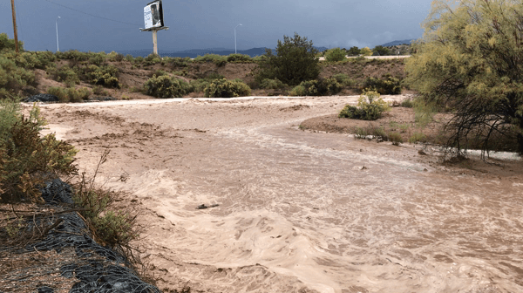
Impacts of Extreme Weather
Flooding, flash flooding
Transportation shutdown - roads blocked, closed, washed out, cut-off (erosion/debris flows)
Loss of supply lines for food
Loss of power and water
Medical emergencies
Economic losses - agriculture
Courtesy: Kerry Jones NWS Albuquerque

Slide 12
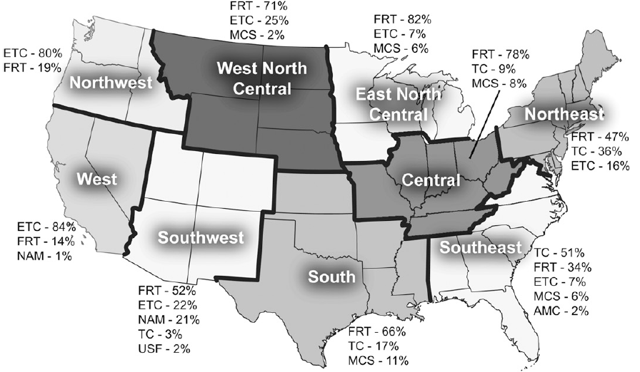
What causes our extreme events?
FRT=fronts
ETC=extratropical cyclones
NAM=monsoon
TC=tropical cyclones
USF=upslope flow
Based on 1908-2009 data
Kunkel et al. (2012) J. Hydrom.

Slide 13
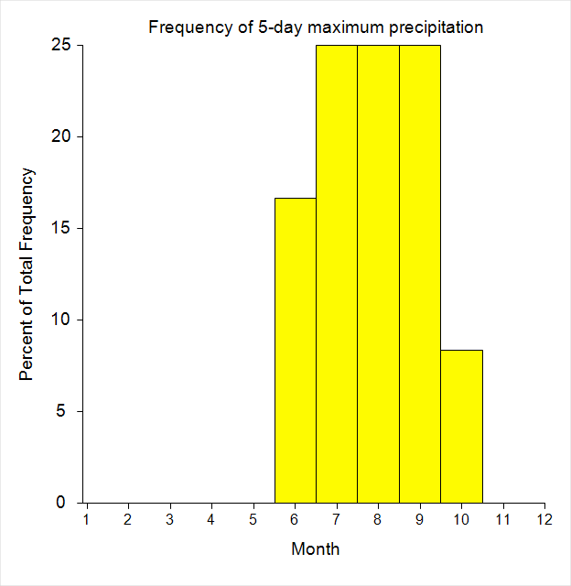
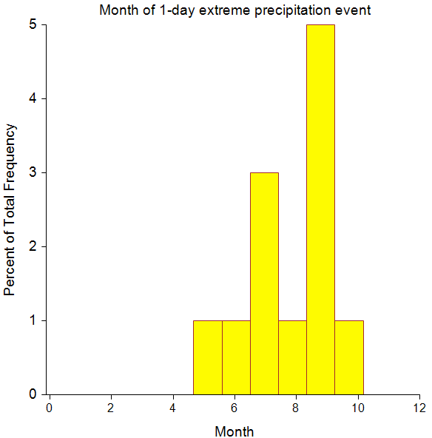
Seasonality of Precipitation Records in NM
September is most frequent month for 1-day record precipitation events across 120 NWS Cooperative stations
5-day record precipitation events equally spread over July, August and September
Data source: http://scacis.rcc-acis.org/

Slide 14
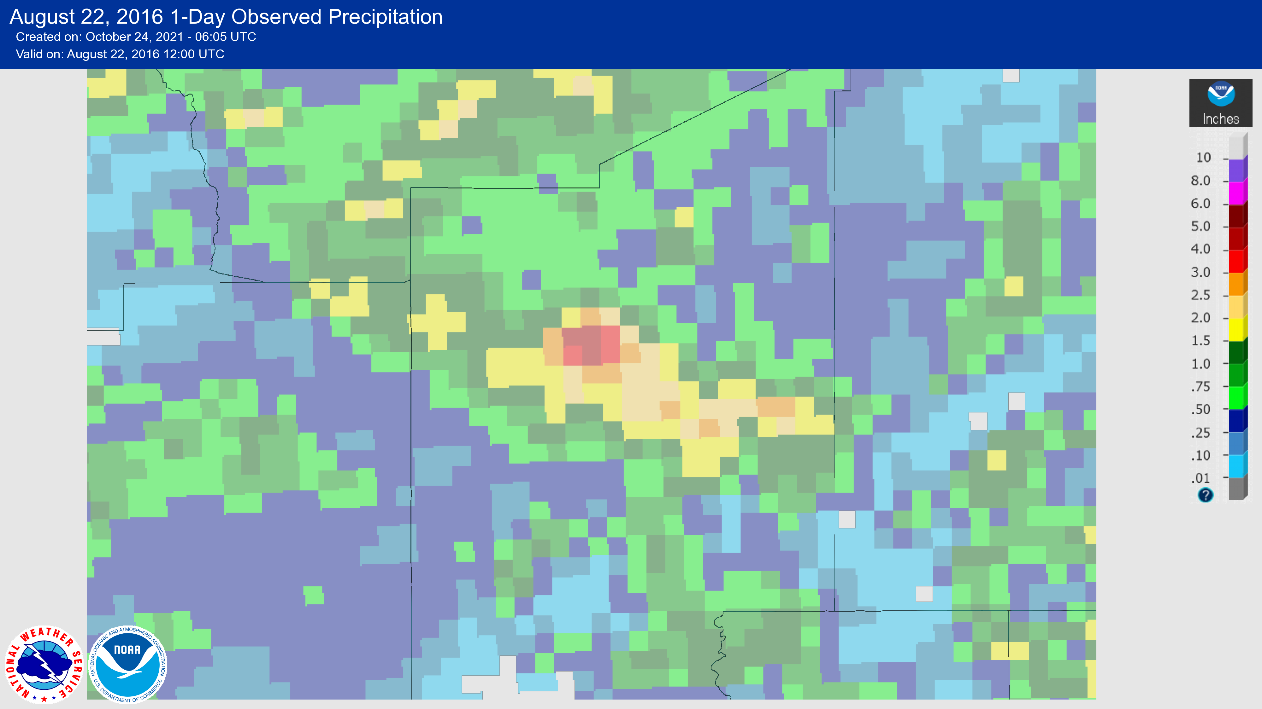

Slide 15
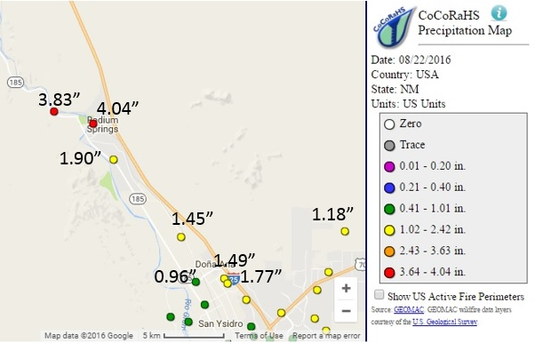
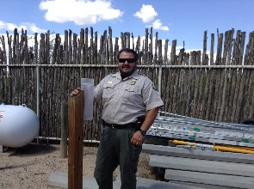
Expanding knowledge of extreme events
Leasburg Dam State Park
CoCoRaHS observer at Radium Springs
August 22, 2016

Slide 16
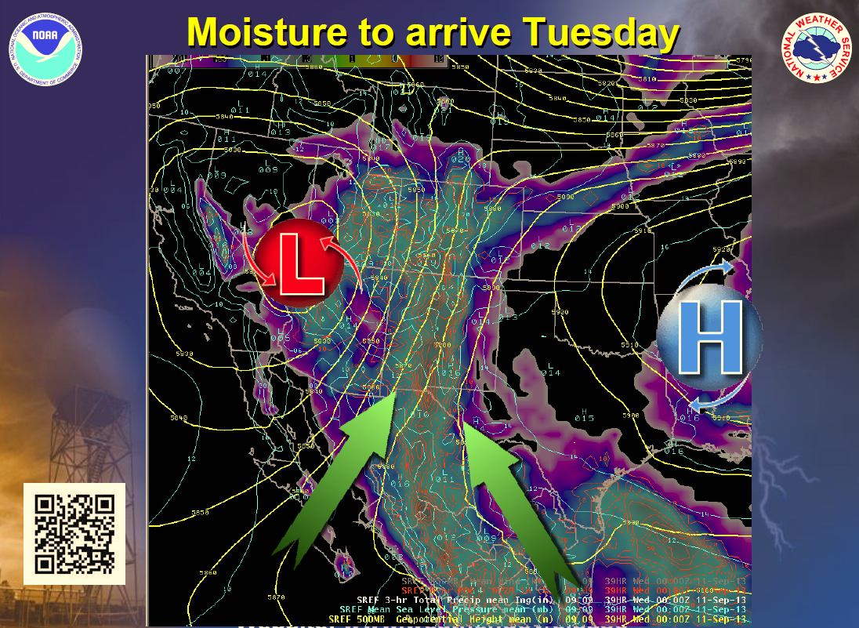
NWS forecast briefing on September 9, 2013

Slide 17
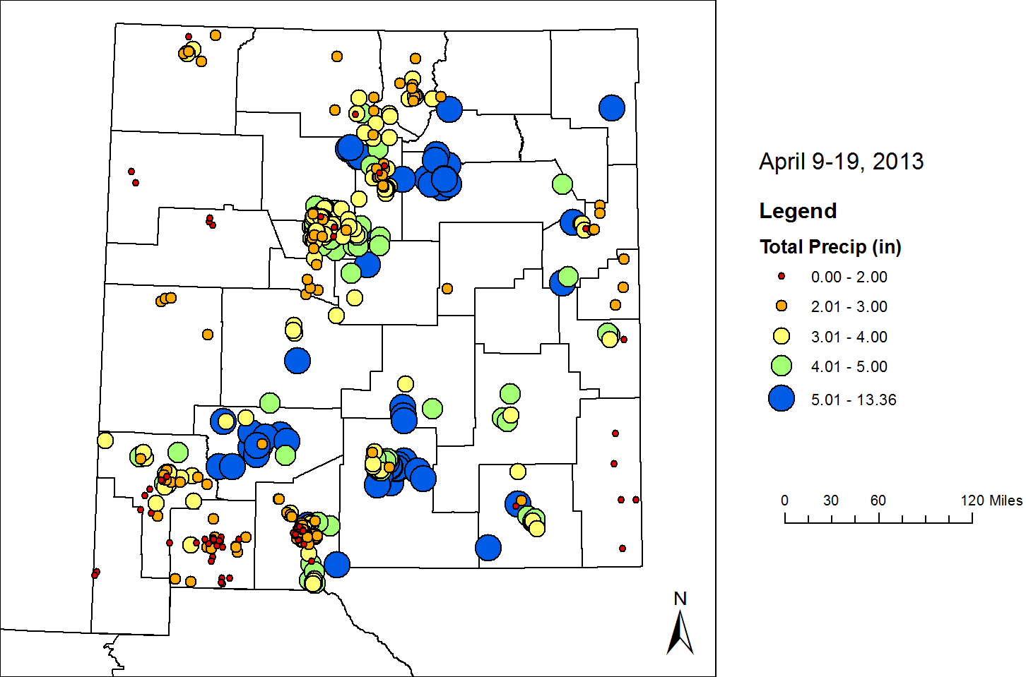
Sept. 2013 Rain Event
NM State Emergency Operations Center was in command at Level 2 operations for several days
NM records broken in Sept 2013
9/10 Los Alamos 13W CRN, 2.06"
9/11 Mountainair 8NW coop, 2.19"
9/12 Bitter Lakes NWR coop, 5.00"
9/12 Quemazon Snotel, 3.40"
9/12 Rosebud 7NW coop, 2.83"
9/13 Los Alamos coop, 3.52"
9/13 TorC airport, 3.28"
9/13 Rice Park Snotel, 3.60"
9/14 Cochiti Dam coop, 2.50"
9/14 Rio Rancho #1 coop, 1.77"
9/18 Deming airport, 2.09"
12.91” Las Vegas
Sept. 9-19, 2013
8.13” Cloudcroft
11.19” N. Carlsbad Caverns
15.76” at Guadalupe Mtns National Park

Slide 18
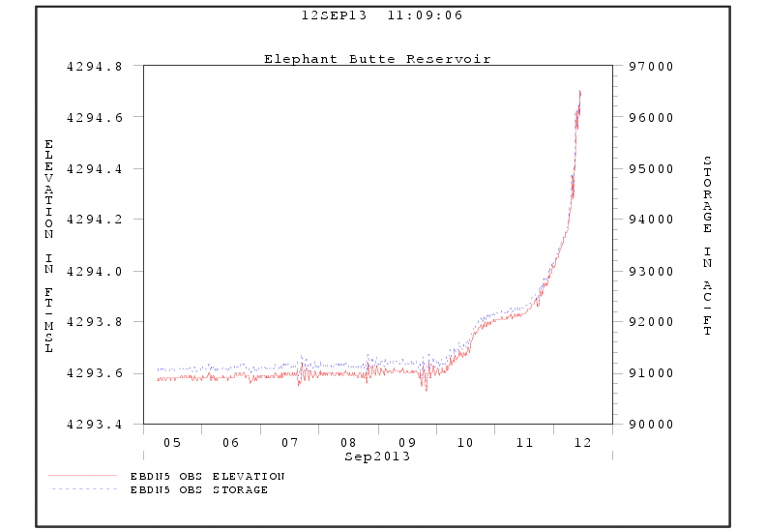

Slide 19
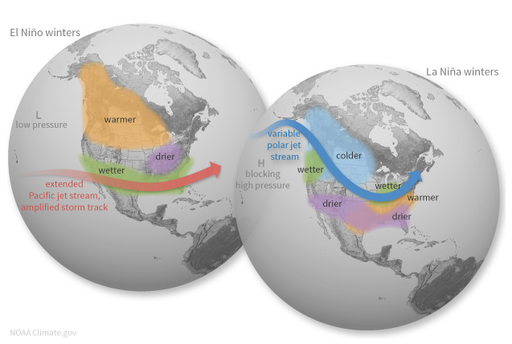
ENSO impacts to North America
https://www.climate.gov/enso

Slide 20
Extremes from tropical remnants
September 1941
September 1942
October 1911
  Flood of record for the Animas River at Farmington (estimated 30,000+ cfs)
Ed Polasko, ABQ NWS ret.

Slide 21
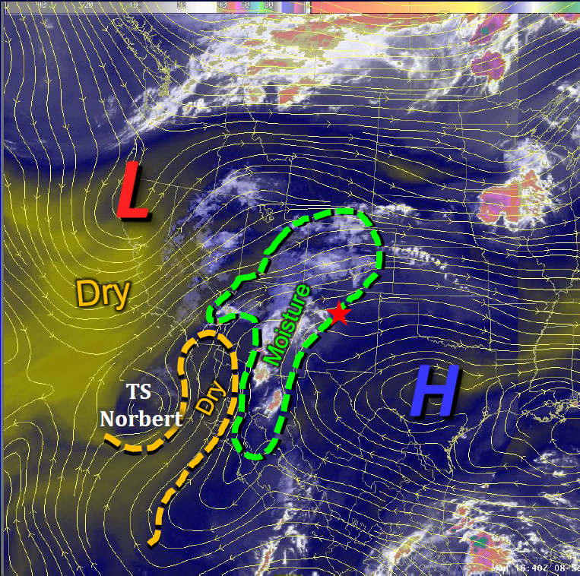
Tropical Storm Norbert Sept. 8, 2014
NWS ABQ briefing

Slide 22
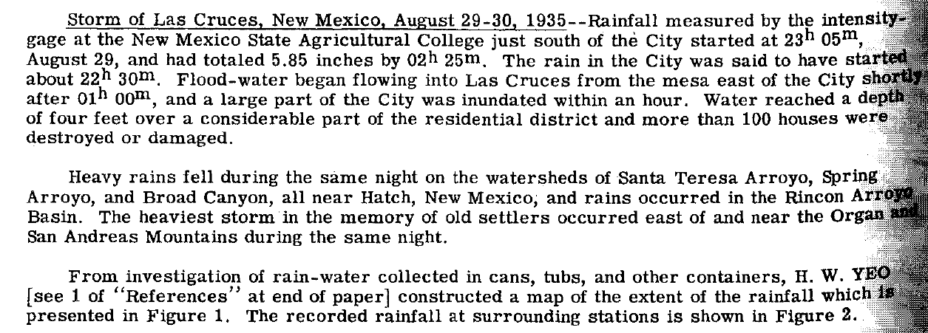
1935 Las Cruces Record
from L.B. Leopold, papers Hydrology, 1942

Slide 23
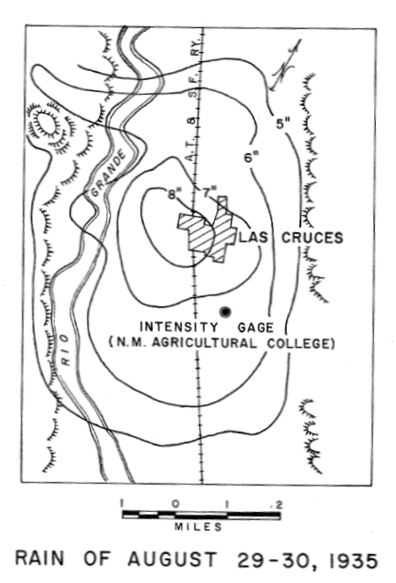
All Time Record Rainfall in Las Cruces
6.49 inches at NMSU
Estimated even higher west of town

Slide 24
2010 Extreme Rain Event
This 3.34 inch rainfall event was the 3rd highest 24-hr precipitation in the record book since 1894 at the NMSU station
Here are the top five precipitation events at the NMSU station

Slide 25
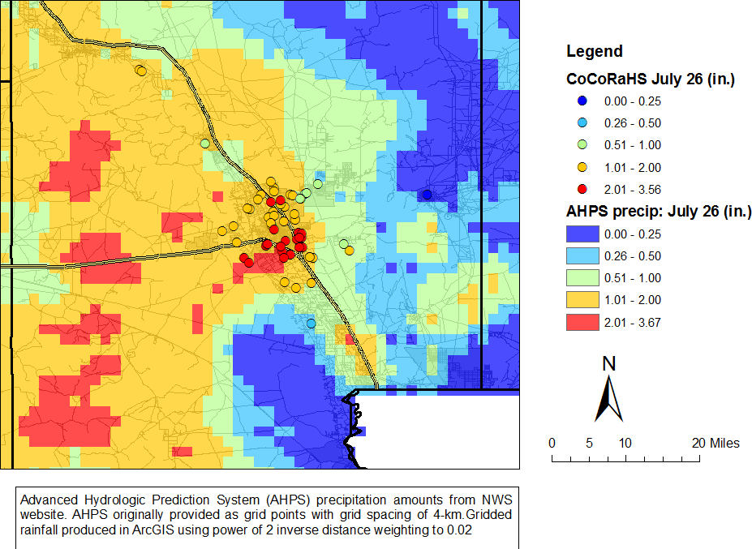
July 25-26, 2010

Slide 26
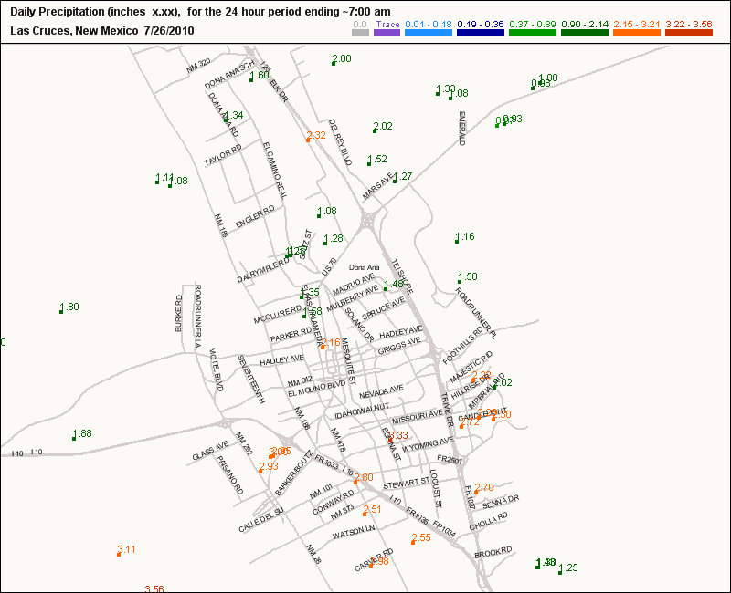
Event Summary in Las Cruces
Rainfall amounts from the evening of July 25 to morning of 26th was 3.34” at the NMSU Coop site
CoCoRaHS showed extent of rain event across Las Cruces
3.56” at site NM-DA-115
1.82” at airport

Slide 27
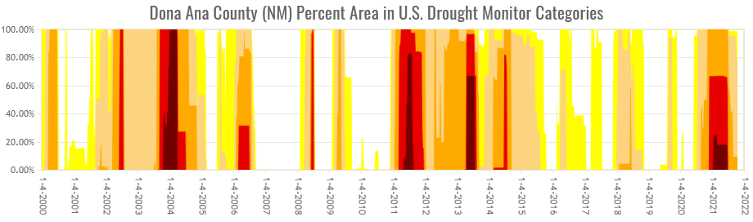
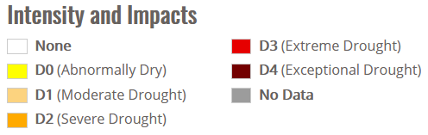
Drought
Above graph is the US Drought Monitor area of Doña Ana County in each drought category since 2000

Slide 28
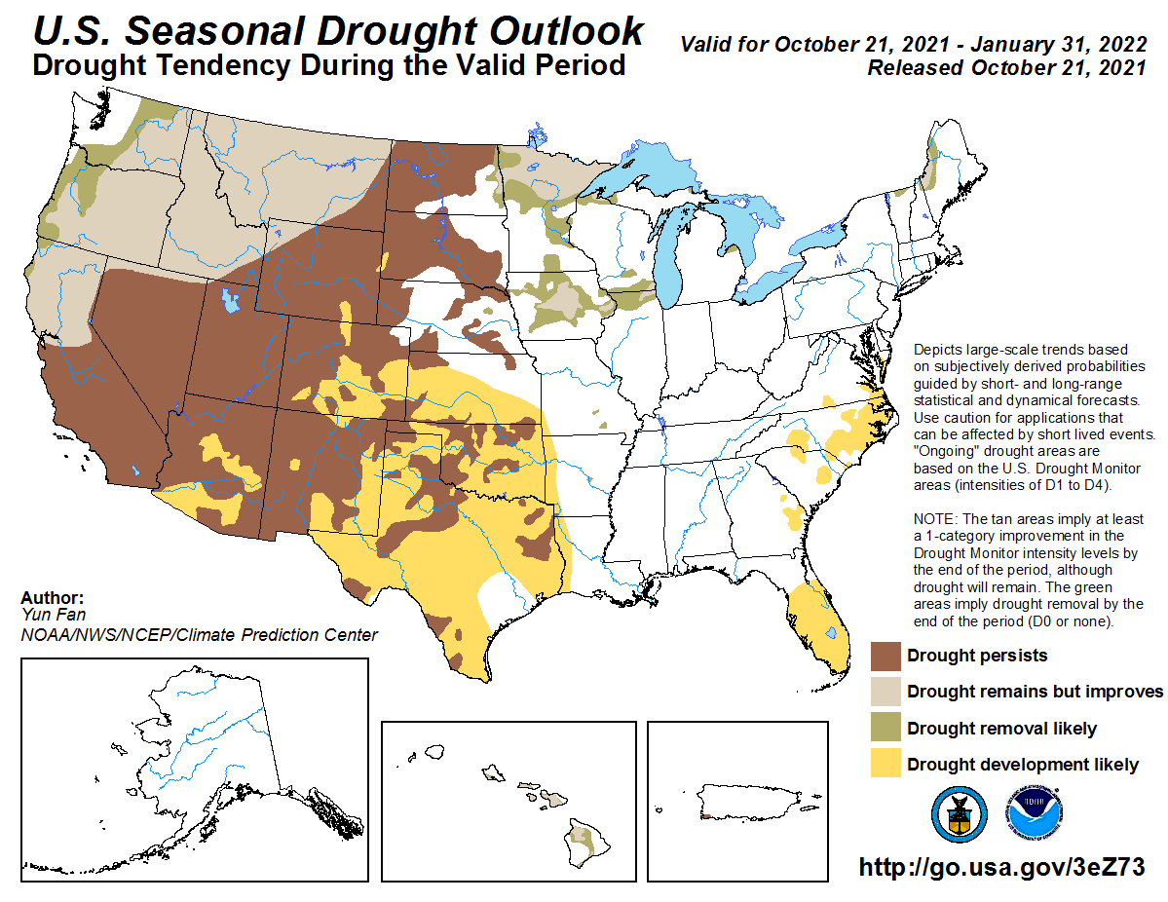
Drought is here to stay at least through the winter

Slide 29
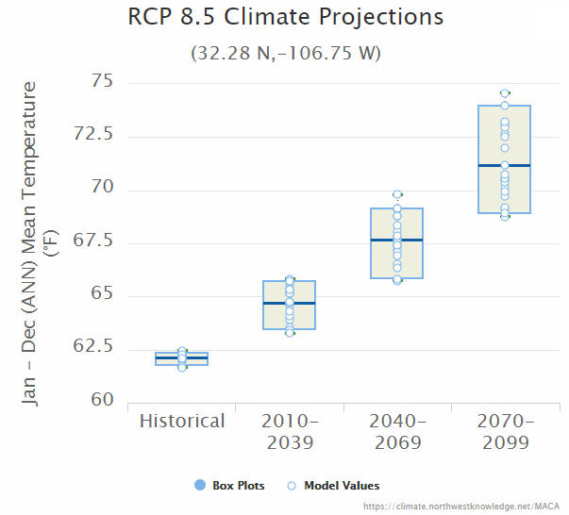
One future climate scenario for Las Cruces
Annual mean
temperatures
historical 62.6°
early century 64.7°
mid century 67.7°
end of century 71.2°
As a rough comparison, Chandler, AZ has an average annual temperature of 71.1F
El Paso has average annual temp of 64.6ºF
Data Source: MACAv2-METDATA, Multi-Model Mean
Multivariate Adaptive Constructed Analogs (Abatzoglou and Brown, 2012)

Slide 30
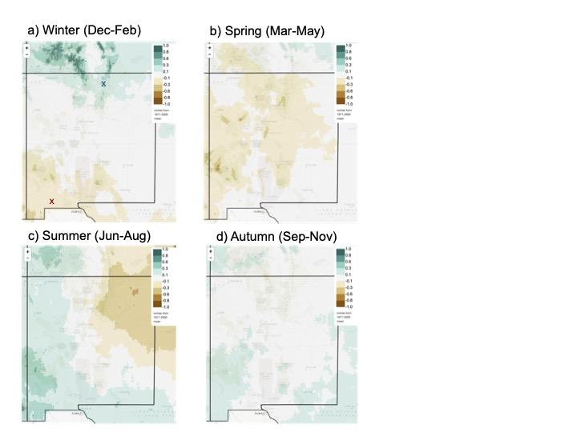
Seasonal Precipitation
Difference between 2040-2069 with past 1971-2000
Spring exhibits a general state-wide drying trend. For much of the state, Spring is already the driest season of the year, so the trend toward less Spring precipitation (combined with hotter temperatures) represents a clear trend toward aridity.
Summer includes a modest trend toward stronger monsoon precipitation in the southwestern corner of the state, combined with a trend toward less precipitation in the northeast. The latter feature is part of a more general geographical trend toward drier summers in central North America

Slide 31
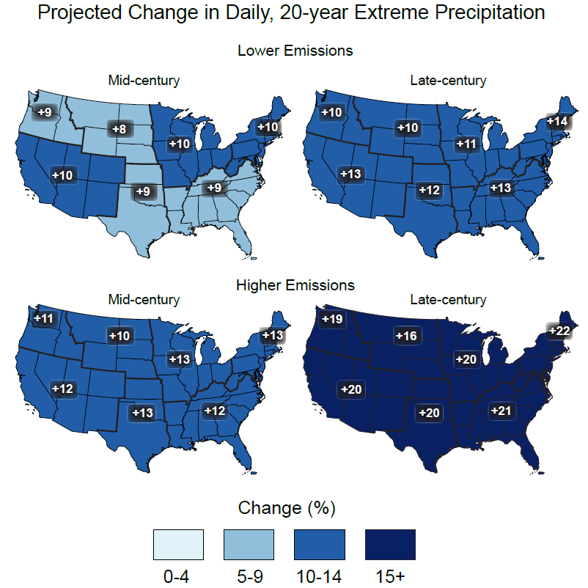
Trends in Extreme Precipitation
Projected change in the magnitude of extreme precipitation events, defined as the one-day precipitation maximum expected once/20 years, derived from statistically downscaled CMIP5 climate model simulations
All changes projected nationwide are positive, indicative of higher 20-year return values of maximum daily precipitation
USGCRP, 4th NCA, volume I (2017)

Slide 32
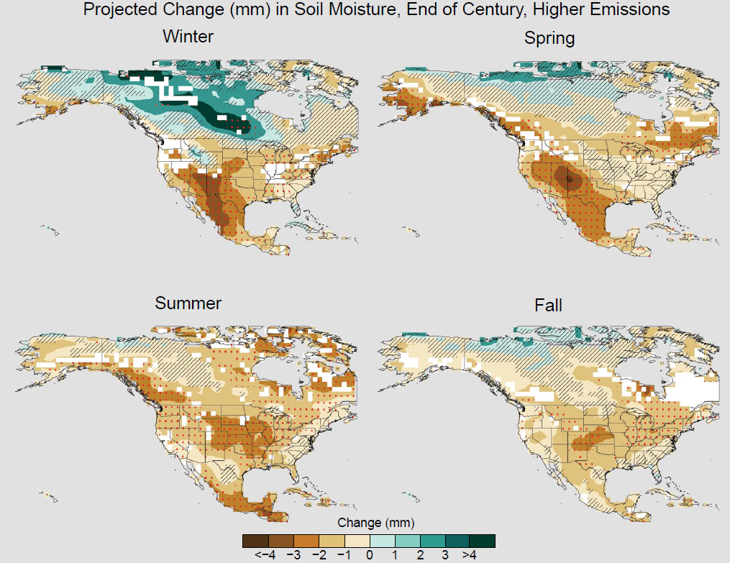
Trends in Soil Moisture
Soil moisture occurs with increased PET
Map based on RCP8.5 scenario in 4th National Climate Assessment
Top 10cm of the soil
Most pronounced declines in soil moisture are expected in winter and spring
USGCRP, 4th NCA, volume I (2017)

Slide 33
Dave DuBois
Department of Plant and Environmental Sciences
NMSU College of Agricultural, Consumer and Environmental Sciences
Las Cruces, NM
Email: dwdubois@nmsu.edu
Office: 575-646-2974
Twitter @nmclimate

